Slide 1
Fundamentals of
DATA VISUALISATIONS
Notes:
They carry the weight of your arguments
Good visualisations will be the difference between an influential and an obscure paper; grant won and a grant lost.

Slide 2
Visualisations should be…
Clear, Attractive, Convincing, Balanced, Compelling
Convey your data
Not mislead
Aesthetically pleasing
Not distract

Slide 3
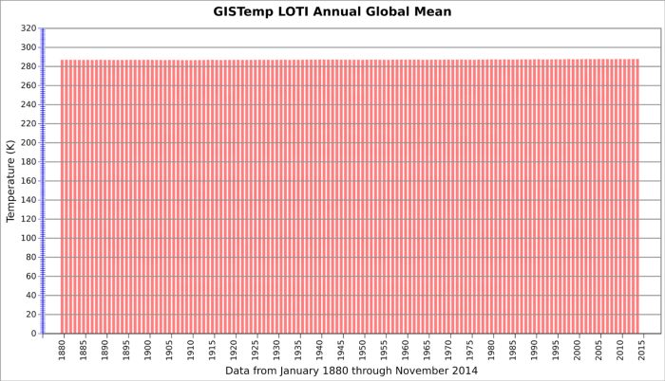
Bad Visualisations

Slide 4
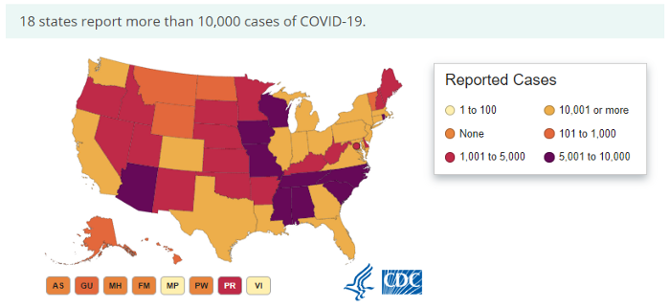
Bad Visualisations

Slide 5
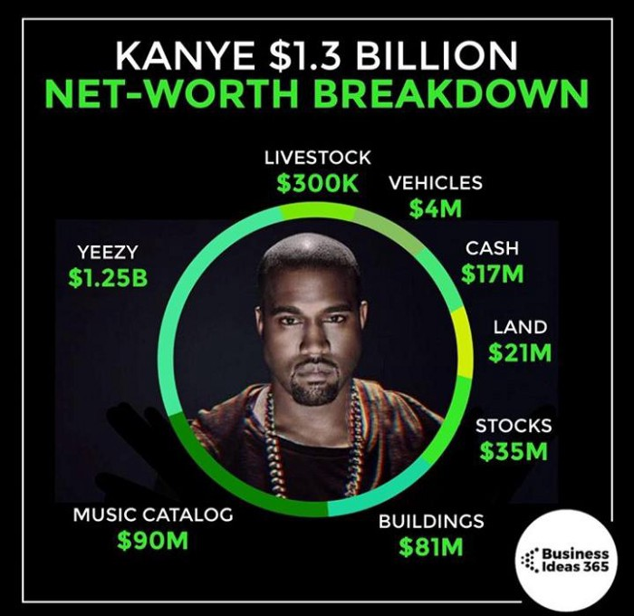
Bad Visualisations

Slide 6
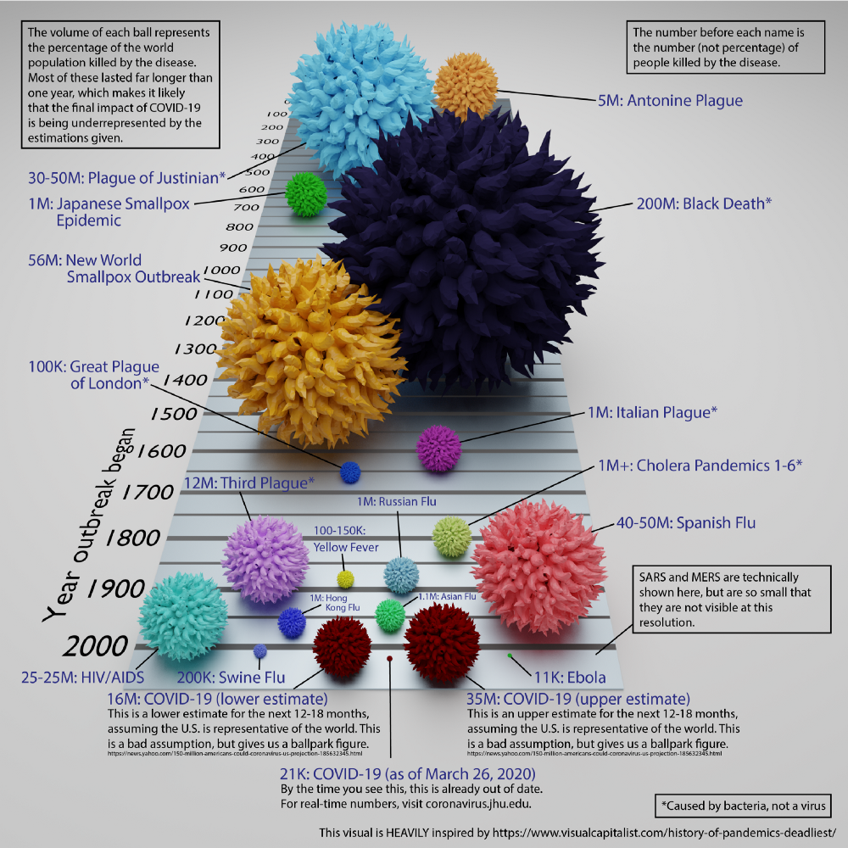
Bad Visualisations

Slide 7
The Grammar of Graphics
Elements | Description
Data | Variables of interest
Aesthetics | X-axis, Y-axis, colour, fill, size, labels, alpha, shape, line width, line type
Geometries | Point, Line, Histogram, bar, Boxplot
Facets | Columns, Rows
Statistics | Binning, Smoothening
Coordinates | Cartesian, fixed, polar, limits
Themes | Non-data ink

Slide 8
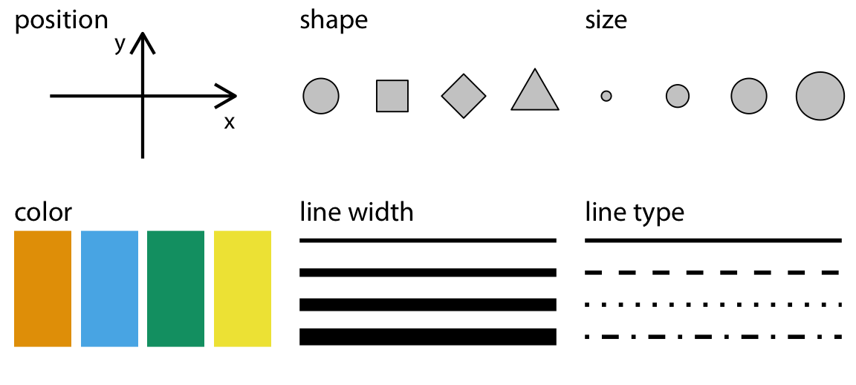
Mapping data to aesthetics
Text – font, size
Transparency, Alpha

Slide 9
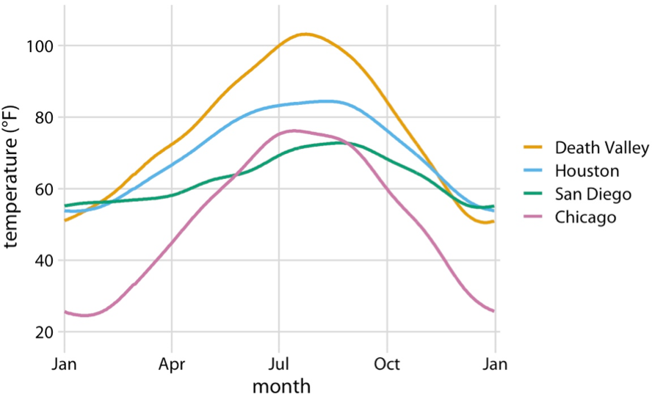
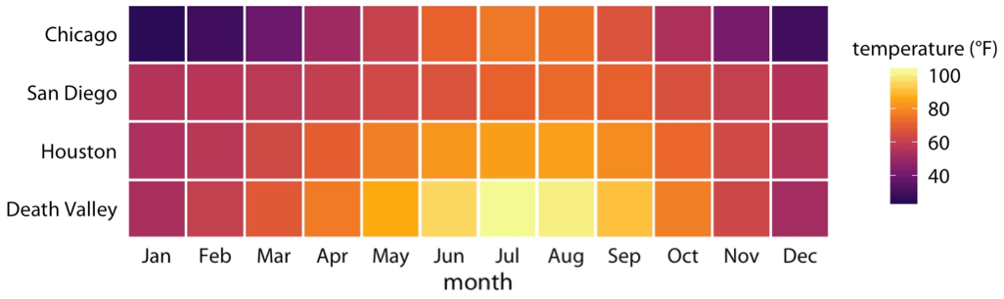
Mapping Data to Aesthetics
Chart 1
X-axis
Y-axis
Colour + Lines
Data
Months
Temperature
Location
Chart 2
X-axis
Colours
Y-axis
Chart 1
Chart 2

Slide 10
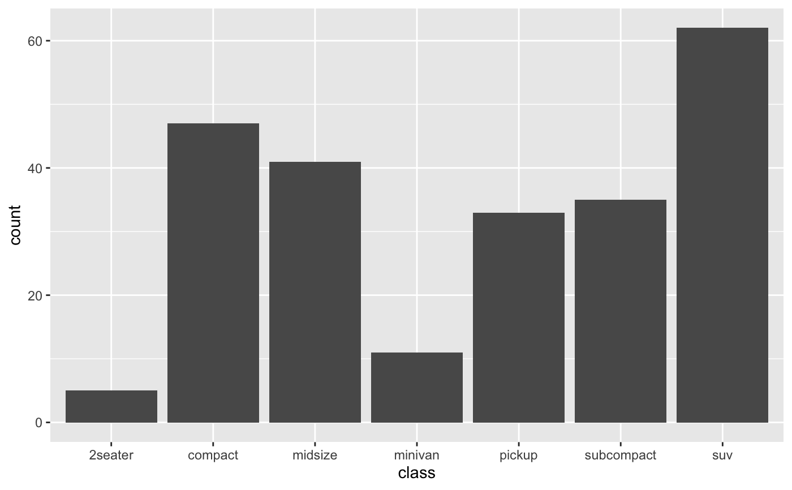
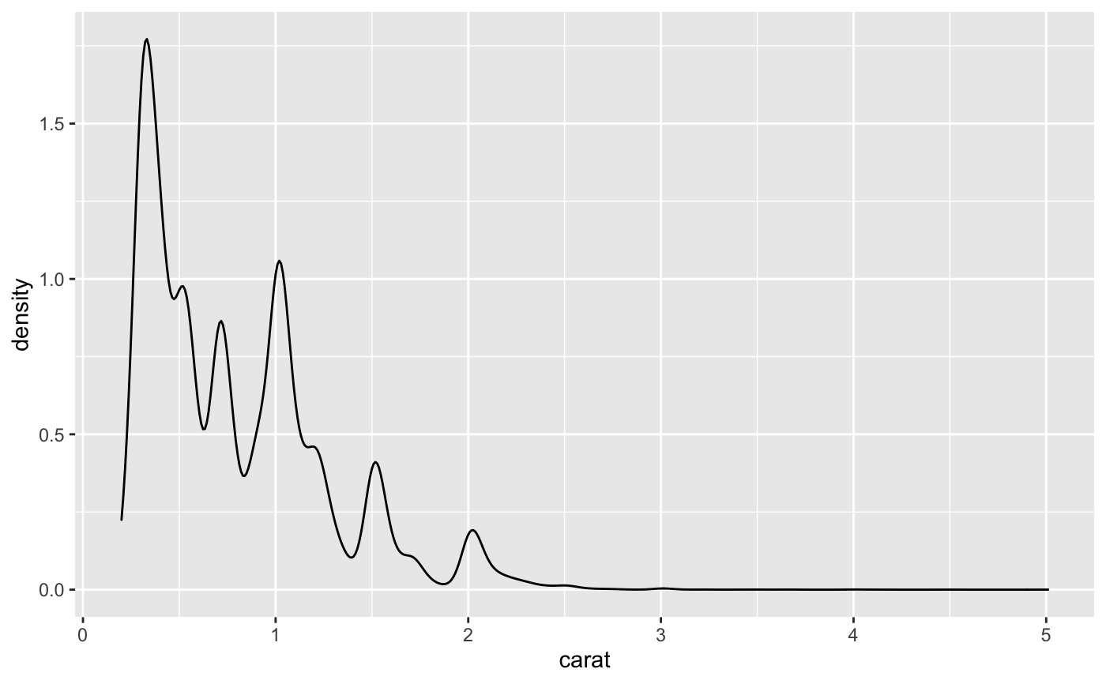
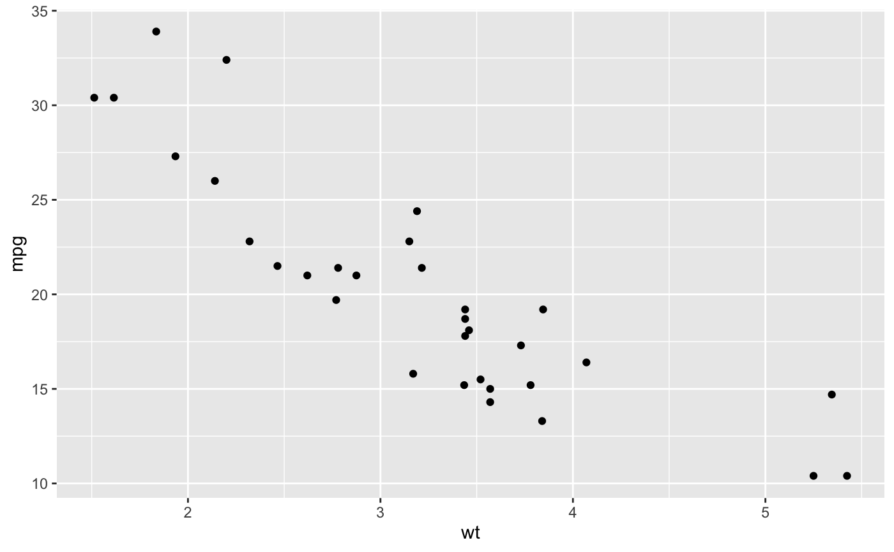
Geometries
Bar
Density
Point

Slide 11
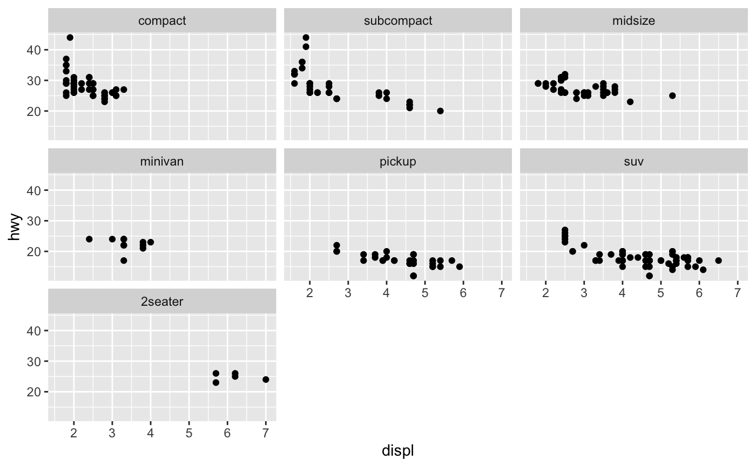
facets

Slide 12
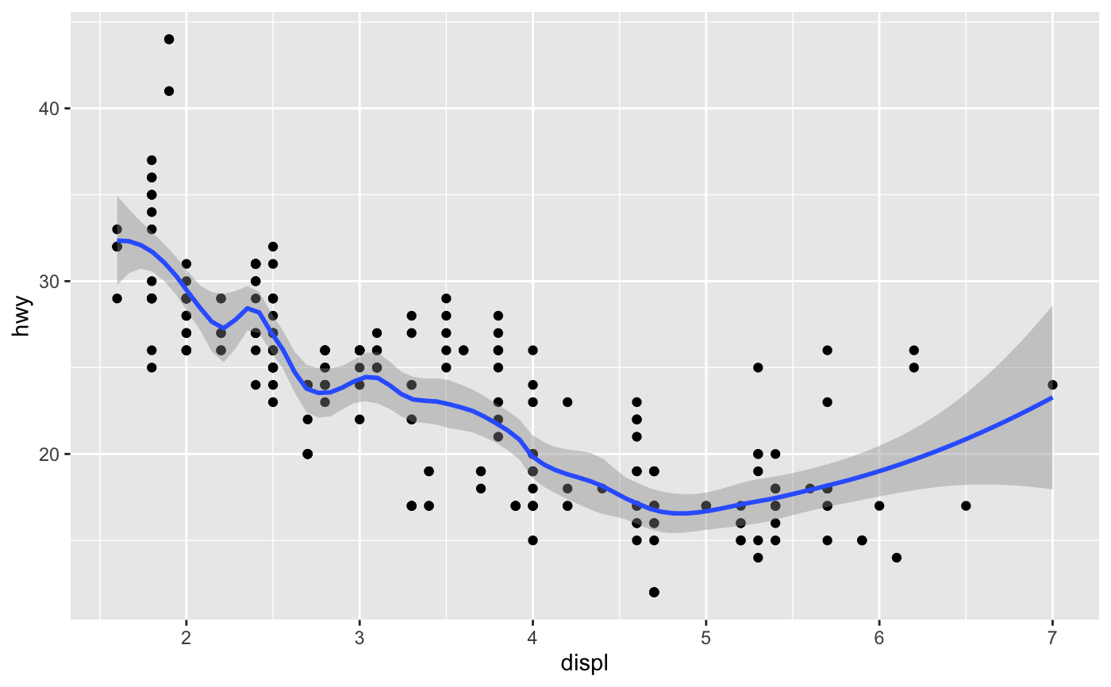
Statistics
Smoothening

Slide 13
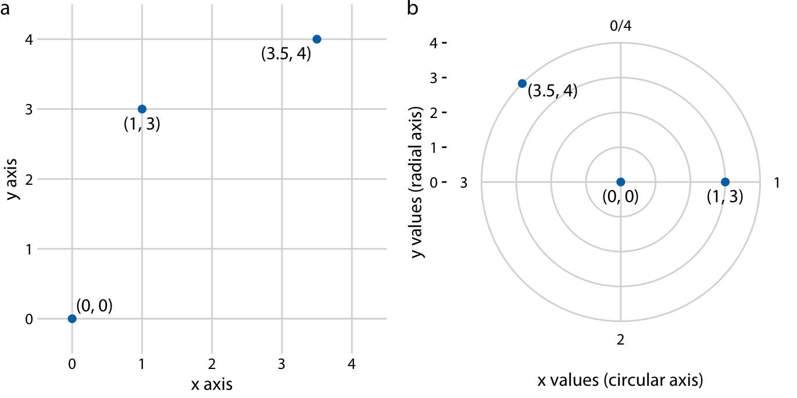
Coordinate system and axis

Slide 14
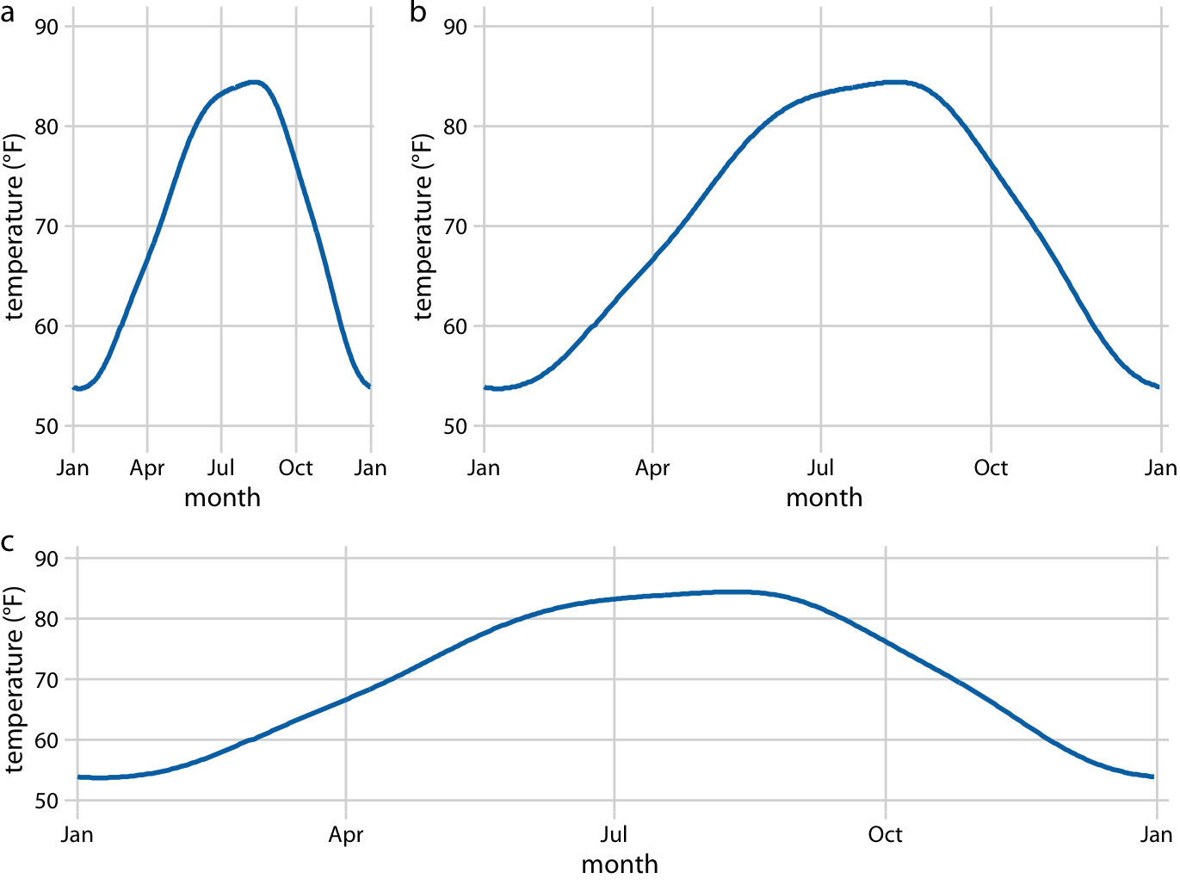
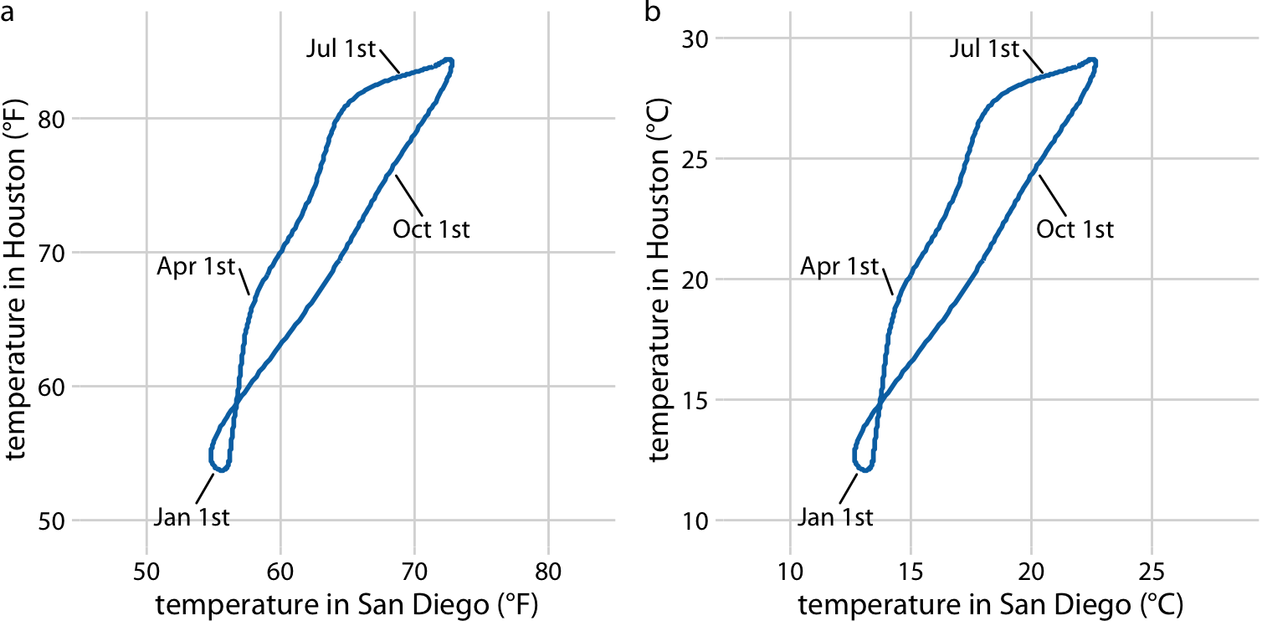
Coordinate system and axis
Scale

Slide 15
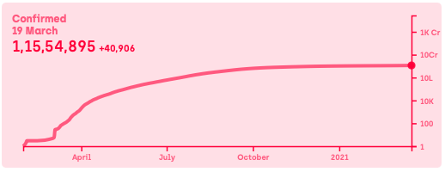
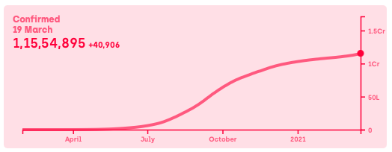
Coordinate system and axis
Log Scale

Slide 16
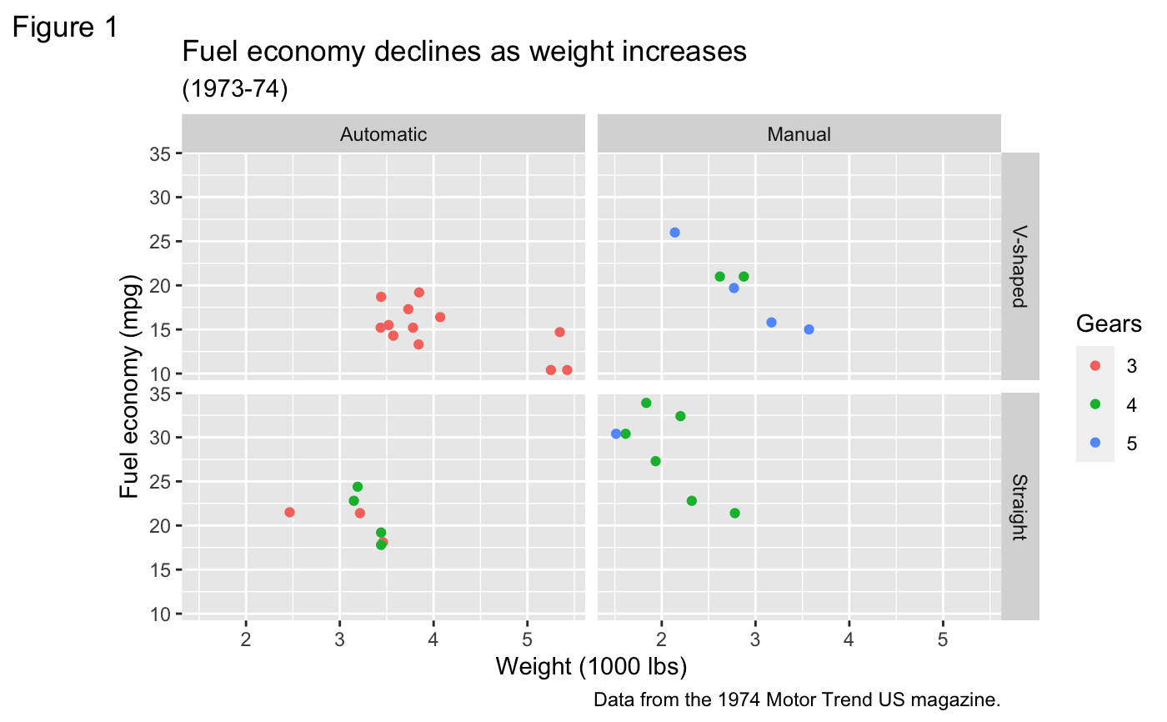
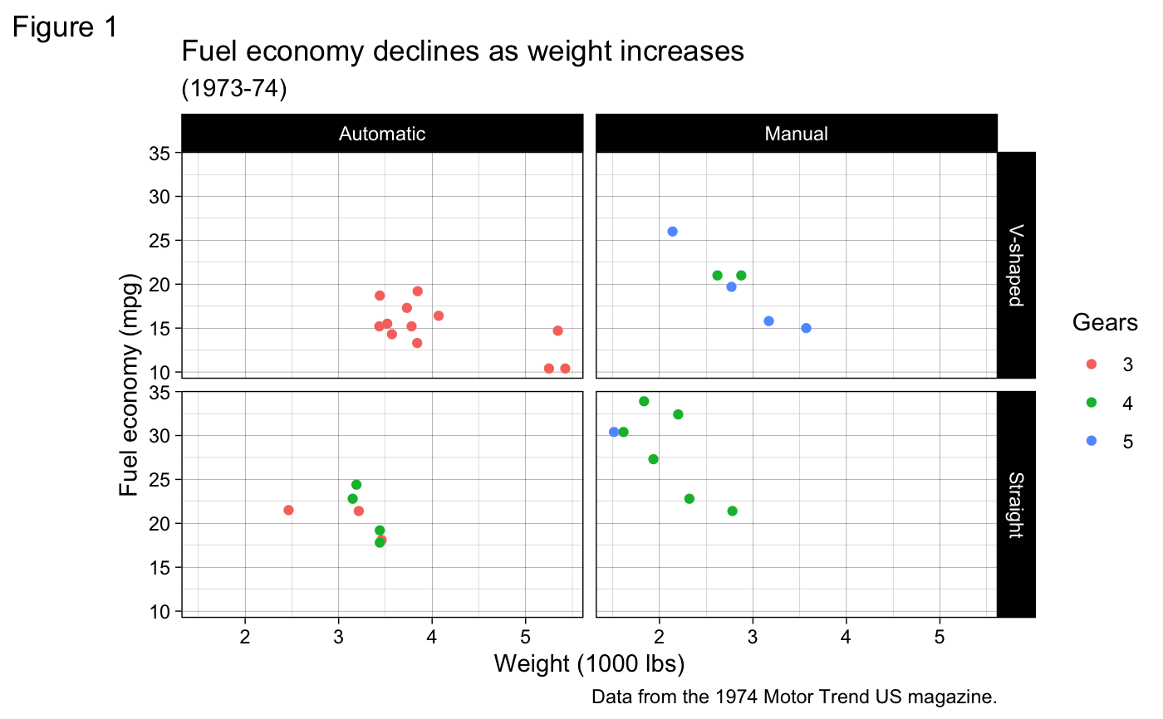
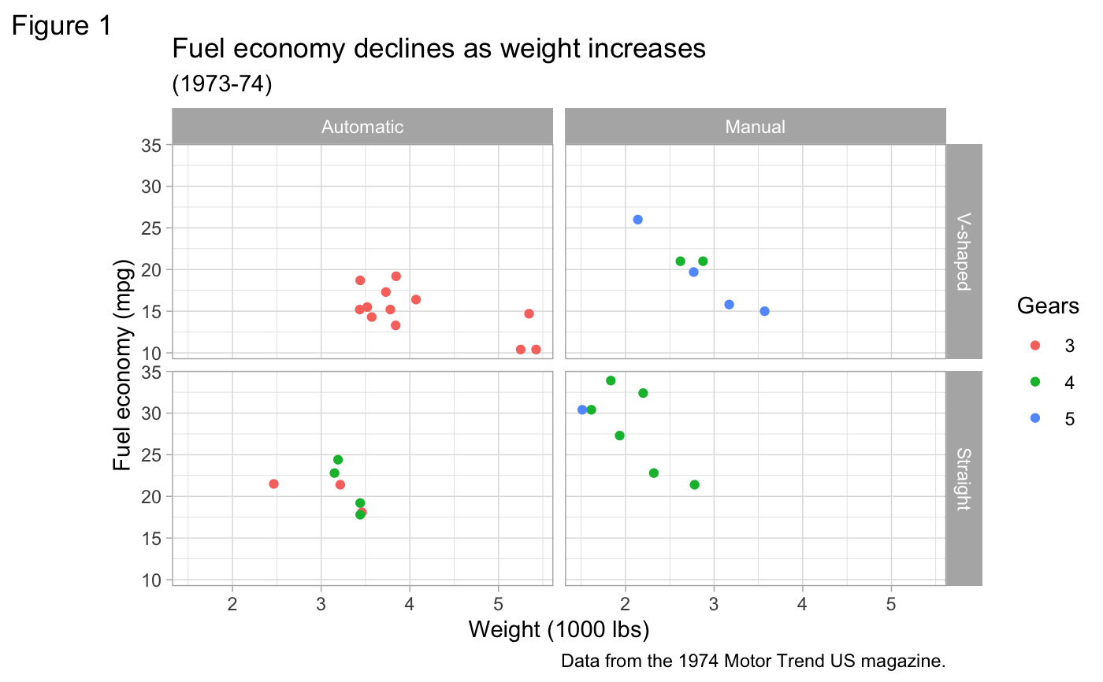
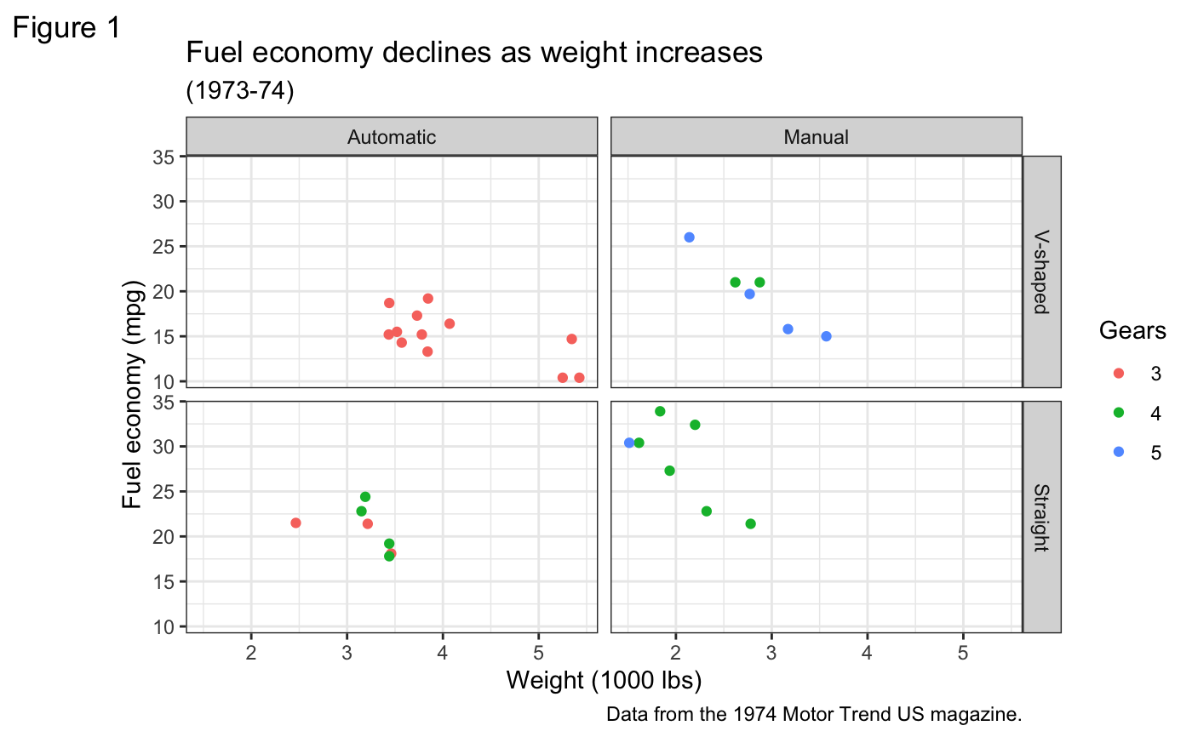
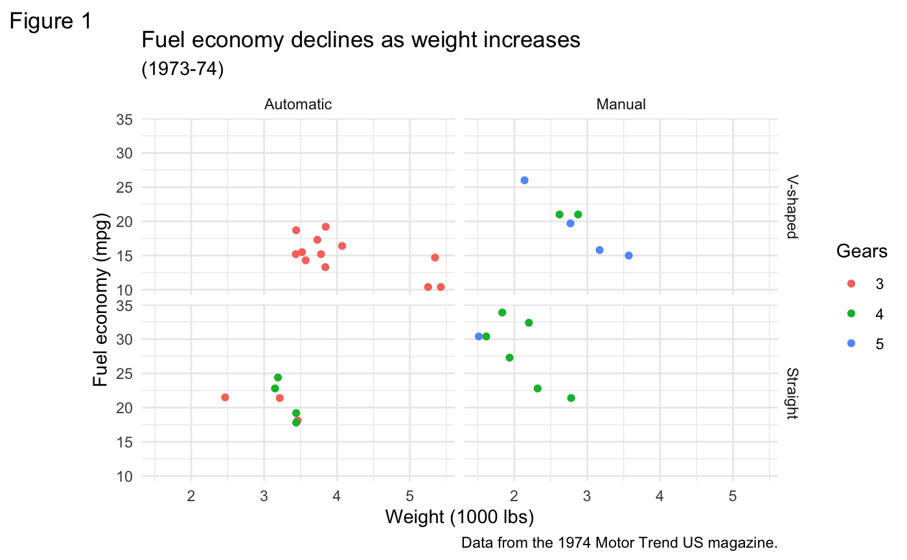
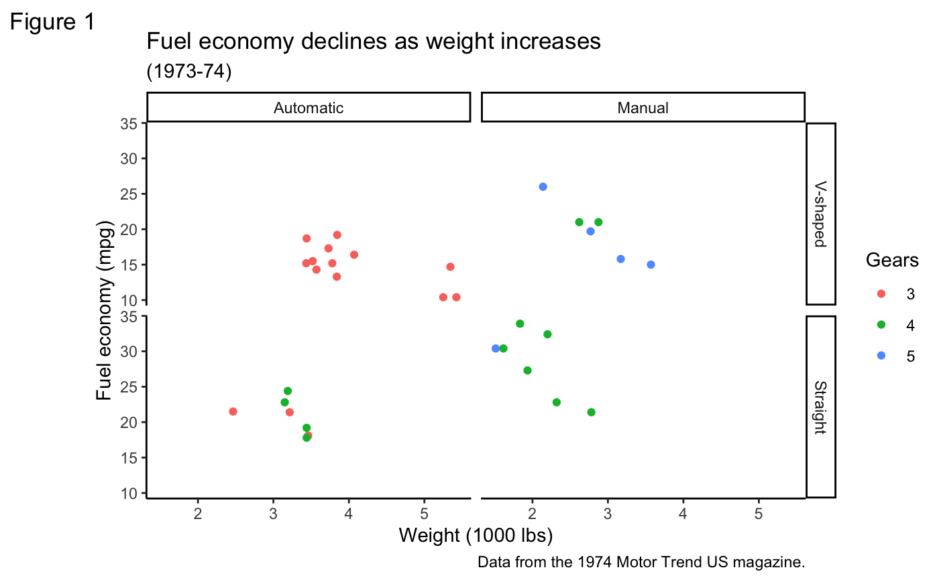
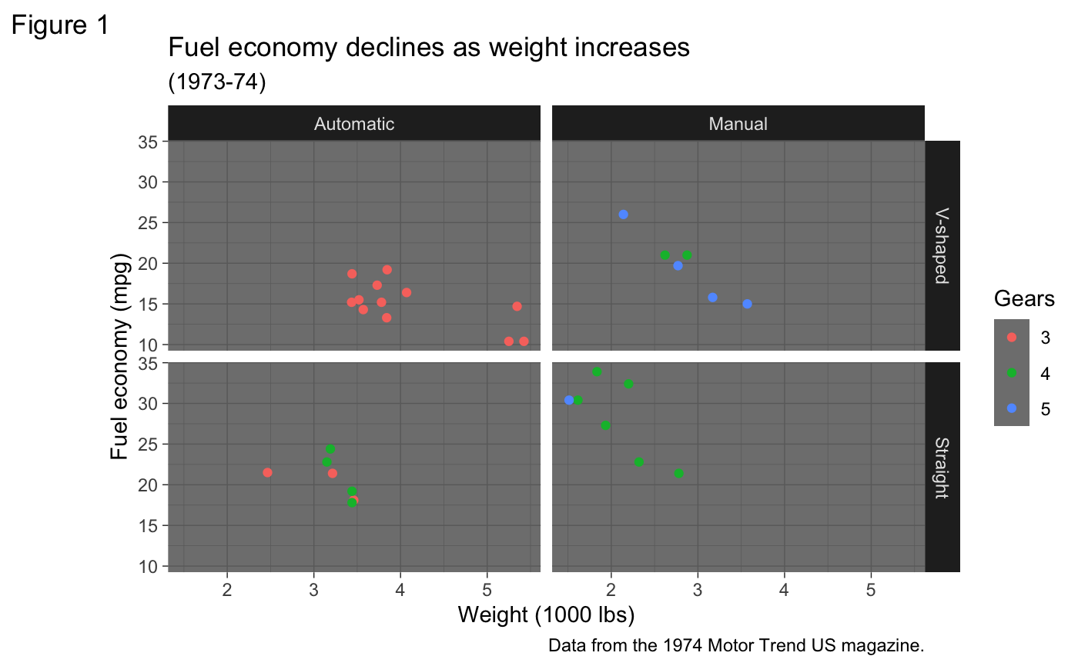
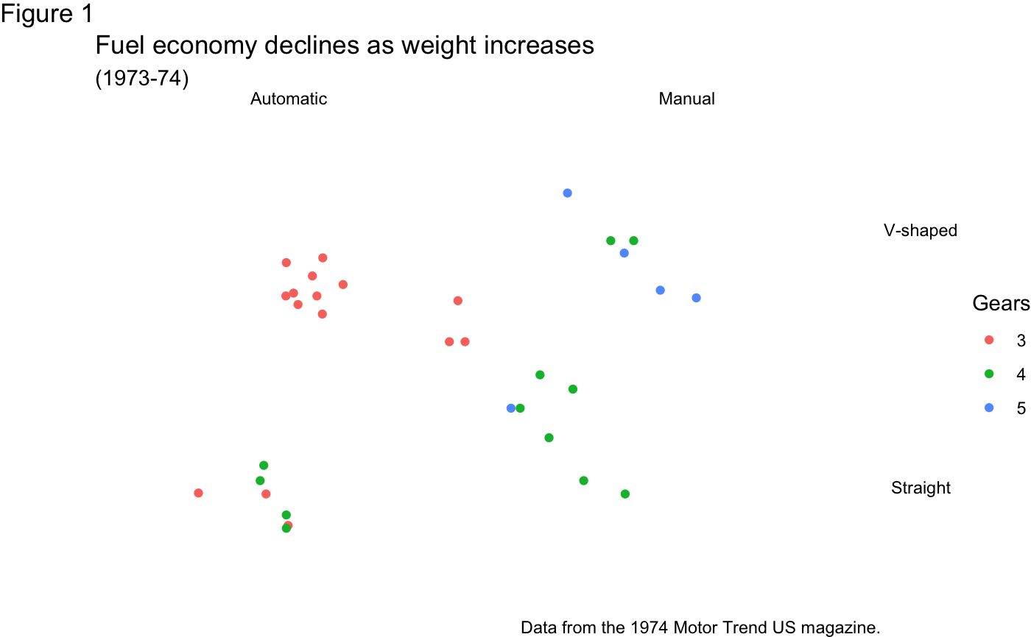
Themes

